Slide 1
COMPUTER NETWORK

Slide 2
AGENDA
Computer network
Wan.man.lan.pan
Hardware
network connecting device
Network topology
Software
OSI MODEL
TCP/IP protocol
Window network command

Slide 3
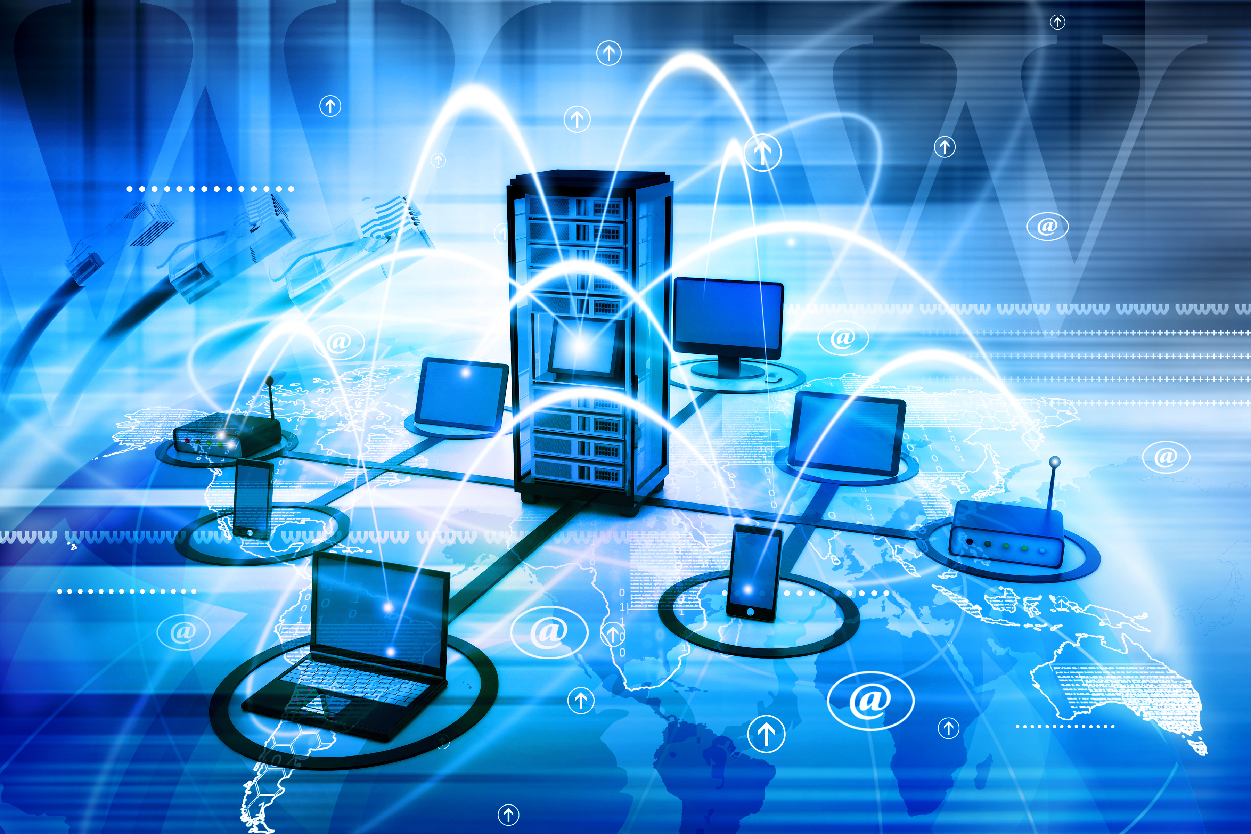
COMPUTER NETWORK
Computer networking
refers to interconnected computing devices that can exchange data and share resources with each other. These networked devices use a system of rules, called communications protocols, to transmit information over physical or wireless technologies.

Slide 4
HARDWARE: NERTWORK CONNECTING DEVICE
L1 devices: repeater hub
L2 devices: bridge switch
L3 devices: router L3 – switch;L3 ASIC + L2 switch
L4 devices:
L7 devices:

Slide 5
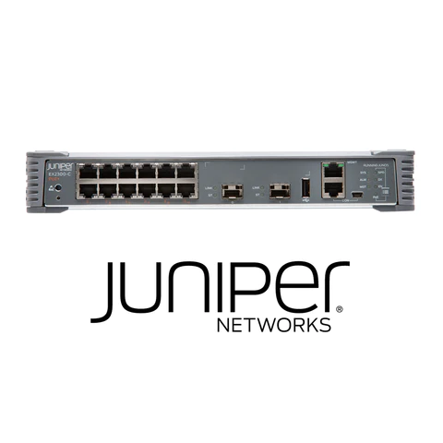
SWITCH VLAN

Slide 6
SWITCH VLAN
A group of end stations and the switch ports that link them together make up a VLAN. The logical split may be justified for a variety of reasons, such as departmental or project membership. The end station and the port to which it is connected must both be members of the same VLAN in order for it to function physically.

Slide 7
VLAN VIRTUAL LOCAL AREA NETWORK
Any broadcast domain that is divided and isolated in a computer network at the data connection layer is known as a virtual local area network (VLAN) (OSI layer 2). [2] [3] A physical object that has been replicated and changed by additional logic within a local area network is referred to in this context as virtual. In order to create the look and functioning of network traffic that is physically on a single network but behaves as though it is split between several networks, VLANs work by attaching tags to network frames and processing these tags in networking systems. Despite being connected to the same physical network, VLANs can maintain network application separation without the deployment of additional sets of cabling and networking hardware.

Slide 8
NETWORK TOPOLOGY
The configuration of a communication network's components—links, nodes, etc.—is known as its topology. Network topology is a term used to define or explain the configuration of many forms of telecommunication networks, such as computer networks, industrial fieldbuses, and command and control radio networks.
The topological structure of a network is known as network topology, and it can be represented physically or conceptually. It is a graph theory application[3] where connecting devices are modeled as links or lines between the nodes, and communicating devices are modeled as nodes. Physical topology refers to where different network elements are located (such as device placement and cable installation), whereas logical topology shows how data moves throughout a network. Even if two networks may have different node distances, physical connections, transmission speeds, or signal kinds, their logical topologies might be the same. The physical layer of the OSI model is particularly interested in the physical topology of a network.

Slide 9
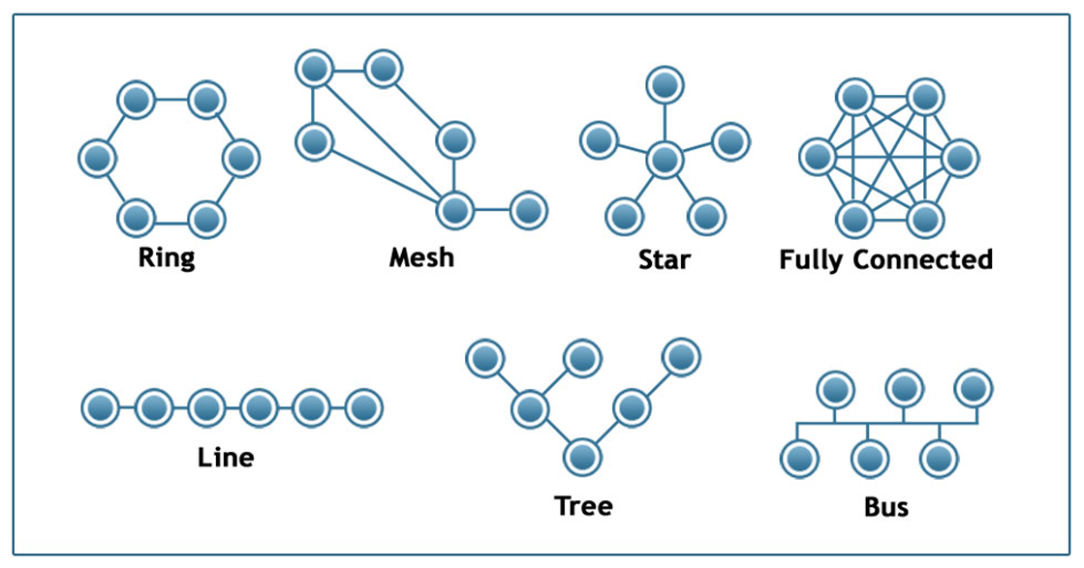

Slide 10
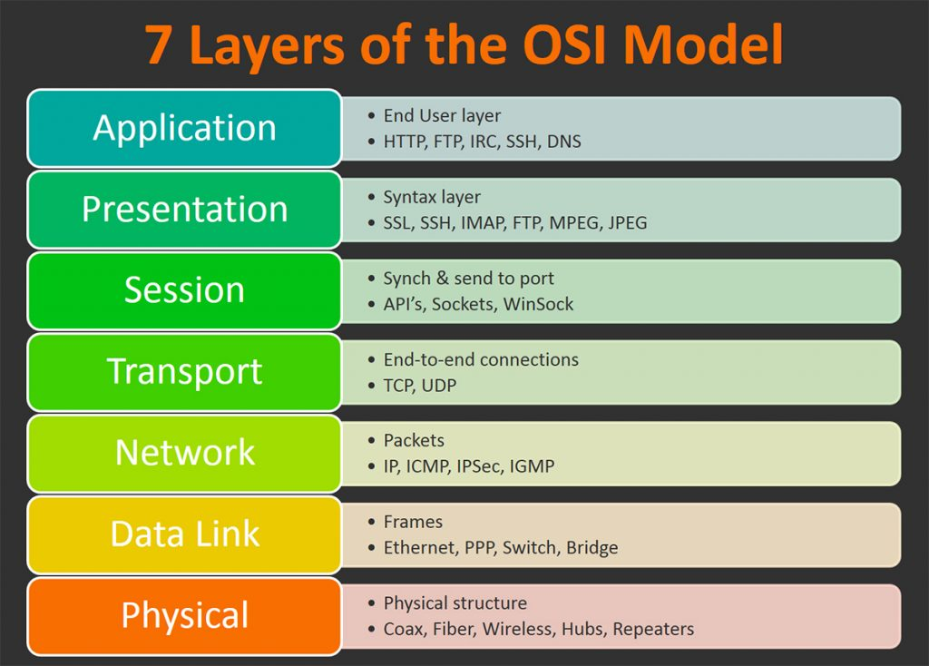
OSI MODEL
The seven levels that computer systems employ to interact over a network are described by the Open Systems Interconnection (OSI) model. In the early 1980s, all significant computer and telecommunications businesses adopted it as the first universal architecture for network communications.

Slide 11
OSI MODEL layer function
Layer 7: Application
End-user applications like web browsers and email clients operate at the application layer. It offers protocols that let computer programs transmit and receive data and give consumers useful information. The Hypertext Transfer Protocol (HTTP), File Transfer Protocol (FTP), Post Office Protocol (POP), Simple Mail Transfer Protocol (SMTP), and Domain Name System are a few examples of application layer protocols (DNS).

Slide 12
OSI MODEL layer function
Layer 6: Presentation
Data is prepared for the application layer by the presentation layer. In order for data to be correctly received on the other end, it specifies how two devices should encode, encrypt, and compress data. Any data transmitted by the application layer is processed by the presentation layer before being delivered via the session layer.

Slide 13
OSI MODEL layer function
Layer 5: Session
The session layer establishes sessions, or channels of communication, between devices. It is in charge of starting sessions, making sure they are active and open while data is being exchanged, and shutting them down once communication is complete. The session layer can also establish checkpoints during a data transmission, allowing devices to pick up where they left off in the event that the session is terminated

Slide 14
OSI MODEL layer function
Layer 4: Transport
Data transferred in the session layer is divided into "segments" by the transport layer at the receiving end. On the receiving end, it is in charge of putting the segments back together in order to create data that the session layer may use. The transport layer performs error control, which determines whether data was received wrongly and, if not, requests it again, as well as flow control, which sends data at a pace that matches the connection speed of the receiving device.

Slide 15
OSI MODEL layer function
Layer 3: Network
The network layer serves two primary purposes. One is dividing segments into network packets, which are then put back together at the other end. The alternative method of packet routing involves finding the optimum route through a physical network. In order to route packets to a destination node, the network layer needs network addresses, which are commonly Internet Protocol addresses.

Slide 16
OSI MODEL layer function
Layer 2: Data Link
The data link layer creates and breaks connections between two network nodes that are physically close to one another. Frames are created from packets, which are then sent from source to destination. This layer is made up of two components: Media Access Control (MAC), which utilizes MAC addresses to connect devices and specifies permissions to transmit and receive data, and Logic Link Control (LLC), which identifies network protocols, does error checking, and synchronizes frames.

Slide 17
OSI MODEL layer function
Layer 1: Physical
The physical layer is in charge of the wired or wireless connections that physically connect network nodes. In addition to defining the connector, the electrical cable or wireless technology connecting the devices, it is in charge of bit rate regulation and the transmission of raw data, which is just a stream of 0s and 1s.

Slide 18
Mesh ‘LAN’ local area network
A local area network (LAN) is a network made up of a number of computers that are connected in a certain area. TCP/IP ethernet or Wi-Fi is used in a LAN to link the computers to one another. A LAN is typically only accessible within a single establishment, such as a school, workplace, group, or church.

Slide 19
COMPUTER NETWORK:SOFT WARE

Slide 20
PHYSICAL

Slide 21
TCP/ICP PROTOCOL SUITE
PICTURE

Slide 22
HTTPS

Slide 23
COMPUTER NETWORK: WINDOW COMMAND

Slide 27
IP CONFIG
NESTRAT
PING

Slide 28
COMPUTER NETWORK

Slide 29
SCENARIO

Slide 30
Tools nestat + task manager + taskkill

Slide 34
